Slide 1
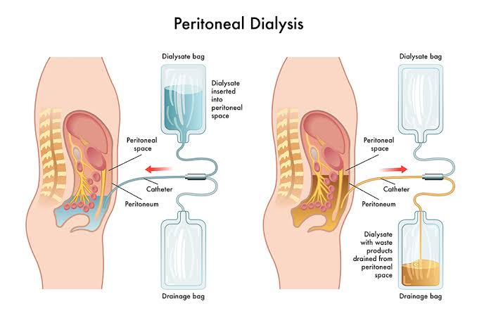
Adequacy of Peritoneal Dialysis
SAP KIDNEY CENTER
BY RIZWAN ALI
DIALYSIS TECHNICIAN

Slide 2
Adequacy of Peritoneal Dialysis
Objectives ; Understand adequacy in peritoneal dialysis (PD)Learn measurement methods Identify factors influencing adequacy Discuss how to improve PD outcomes
SAP KIDNEY CENTER

Slide 3
Adequacy of Peritoneal Dialysis
What is PD Adequacy? Adequacy = Sufficient clearance of waste and fluids Goal: Maintain metabolic balance and prevent uremic symptoms Continuous process vs intermittent HD
SAP KIDNEY CENTER

Slide 4
Adequacy of Peritoneal Dialysis
Components of PD Adequacy Small solute clearance (Urea, Creatinine)Fluid removal (Ultrafiltration)Nutritional status Acid-base and electrolyte balance
SAP KIDNEY CENTER

Slide 5
Adequacy of Peritoneal Dialysis
Key Parameters Kt/V for PD (weekly Kt/V ≥ 1.7) Creatinine clearance (≥ 50 L/week)Residual renal function (RRF)Important contributor to total clearance
SAP KIDNEY CENTER

Slide 6
Adequacy of Peritoneal Dialysis
Types of PD and Impact CAPD (Continuous Ambulatory PD)APD (Automated PD)Volume of dialysate, frequency, and dwell time all affect adequacy
SAP KIDNEY CENTER

Slide 7
Adequacy of Peritoneal Dialysis
Factors Affecting PD Adequacy Peritoneal membrane transport type Dialysate volume and frequency Patient adherence Infections (e.g., peritonitis)Residual kidney function
SAP KIDNEY CENTER

Slide 8
Adequacy of Peritoneal Dialysis
How to Measure Adequacy24-hour dialysate and urine collection Blood tests: BUN, creatinine PET (Peritoneal Equilibration Test)Monthly monitoring
SAP KIDNEY CENTER

Slide 9
Adequacy of Peritoneal Dialysis
Strategies to Improve Adequacy Increase dialysate volume or frequency Use higher glucose concentration if needed Preserve RRF (avoid nephrotoxic drugs)Control infections Patient education on technique and hygiene
SAP KIDNEY CENTER

Slide 10
Adequacy of Peritoneal Dialysis
Role of Dialysis Team Regular monitoring and counseling Early detection of peritonitis or technique failure Training on sterile technique Nutrition and fluid intake advice
SAP KINDEY CENTER

Slide 11
Adequacy of Peritoneal Dialysis
Case Example (Optional)Patient with low weekly Kt/V Intervention: Increase dwell time and volume Outcome: Improved solute clearance
SAP KINDEY CENTER

Slide 12
Adequacy of Peritoneal Dialysis
Conclusion PD adequacy ensures long-term survival Multidisciplinary approach needed Continuous patient support and monitoring is key
SAP KINDEY CENTER

Slide 13
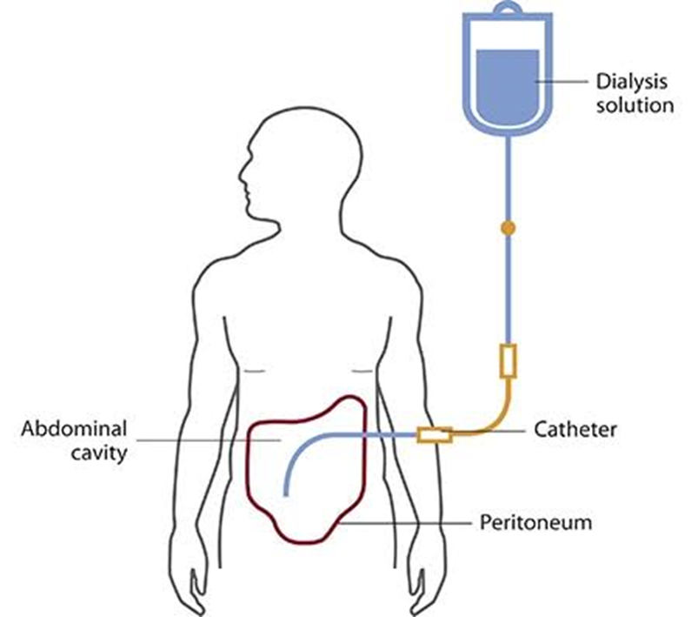
Adequacy of Peritoneal Dialysis
Q&A Questions and interaction with audience
SAP KIDNEY CENTER

Slide 14
Adequacy of Peritoneal Dialysis
THANK YOU
RIZWAN ALI

