Slide 1
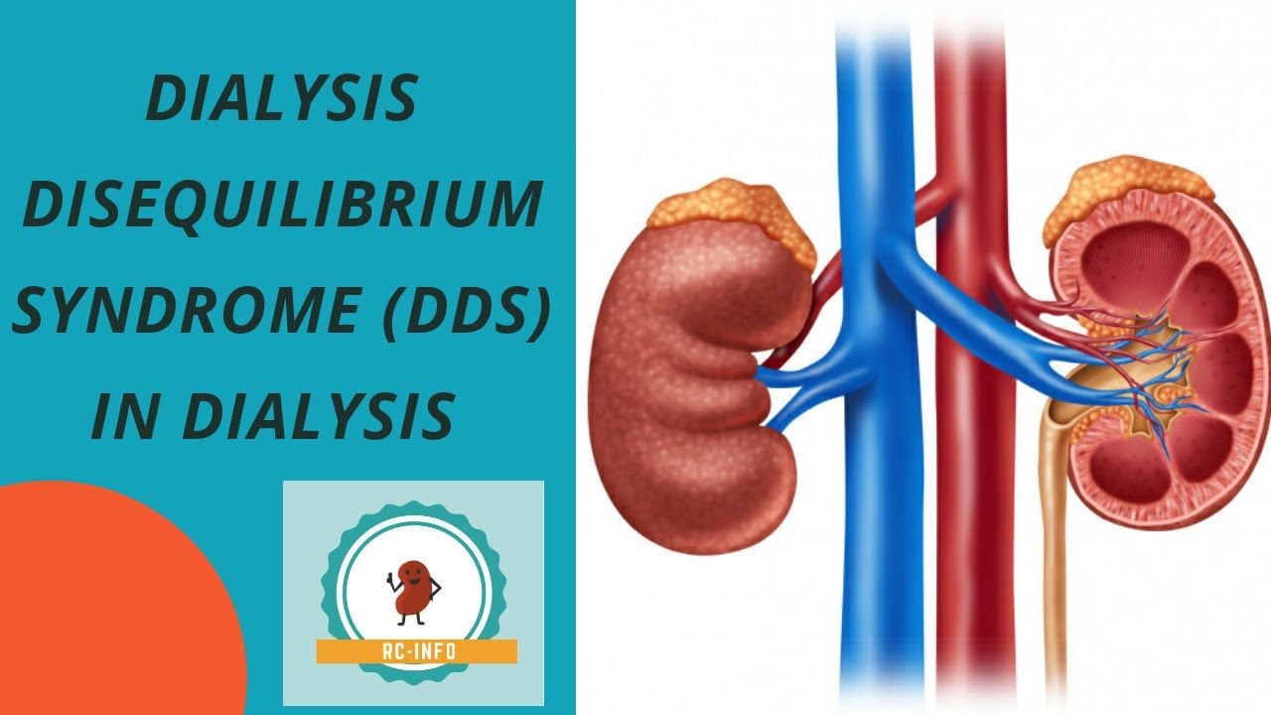
Dialysis disequilibrium syndrome
DDS

Slide 2
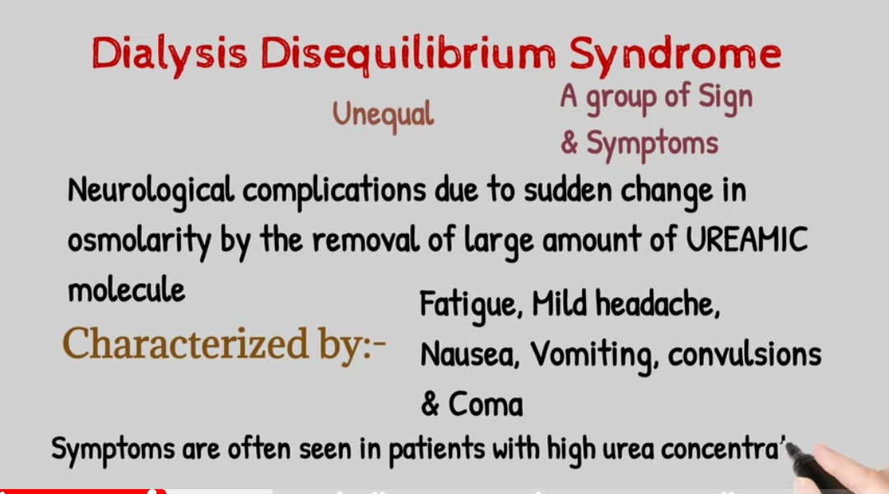

Slide 3
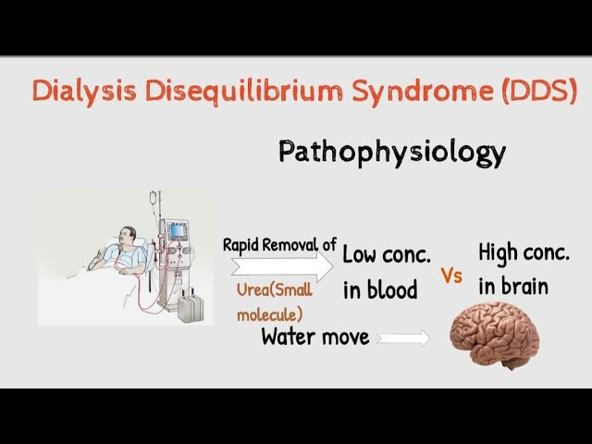
Dialysis Disequilibrium Syndrome Symptoms

Slide 4
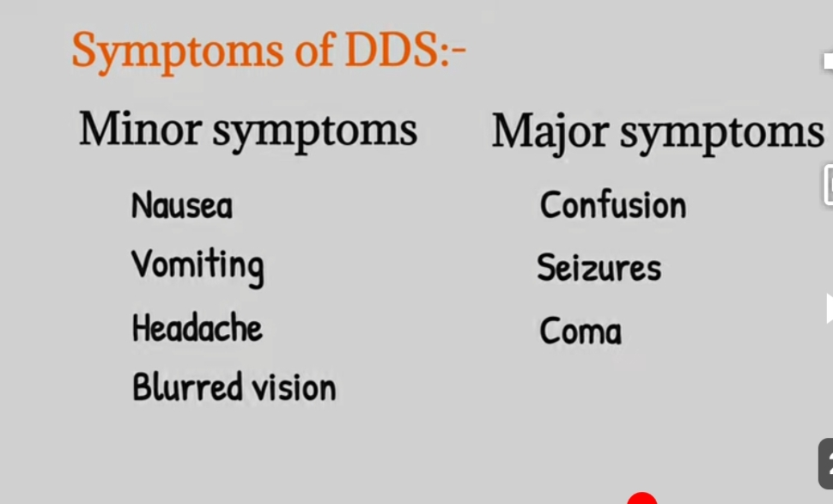
Dialysis disequilibrium syndrome (DDS) is a disorder of the central nervous system
With recent improvements in dialysis and early institution of dialysis
DDS has less common but can present as

Slide 5
More serious manifestation
coma
DDS usually occurs towards the end of or after the termination of dialysis
It tends to be self-limiting. With a complete recovery, which occurs slowly

Slide 6
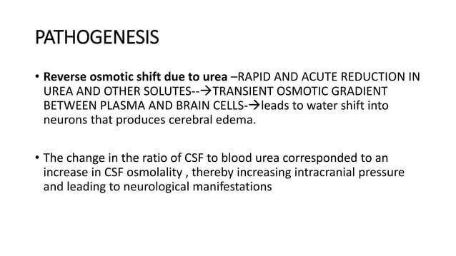
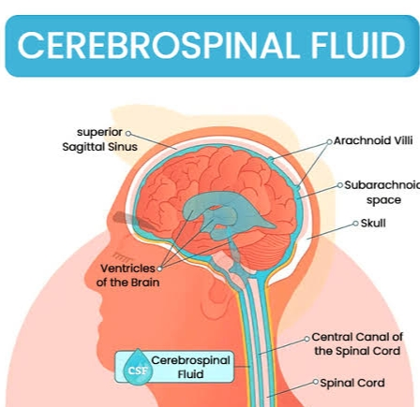
The pathogenesis of DDS is unclear,
But it is believed to be caused by a rapid shift of plasma osmolarity and/or of plasma pH.

Slide 7
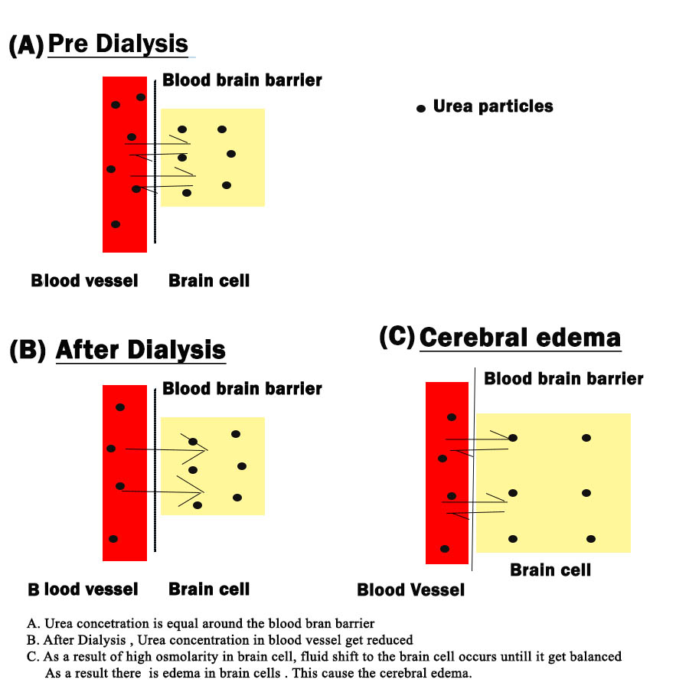

Slide 8
A rapid decline in plasma osmolarity in severe uremia (with higher osmolarity) could shift water anto brain cells causing swelling and DDS
Similarly, A rapid rise in blood bicarbonate in a severely acidotic patient may cause a rapid decrease in plasma pH and lead to the development of neurological manifestations.
As edema of brain tissue appears to underlie the syndrome,
the prevention of a rapid decline in serum osmolarity is effective in preventing DDS

Slide 9
Patients with severe uremia, or with hypernatremia, the dialysate sodium concentration should be higher and the difference between dialysate and plasma sodium concentrations should be small
Hypernatremia
A high concentration of . sodium in the blood.
The dialysis process should be slow and less efficient dialyzers should be used.
In an acute setting
One dialysis session should not attempt to correct the uremic syndrome but rather, the targeted urea reduction should be less than 30% per treatment during the initial few treatments.

Slide 10
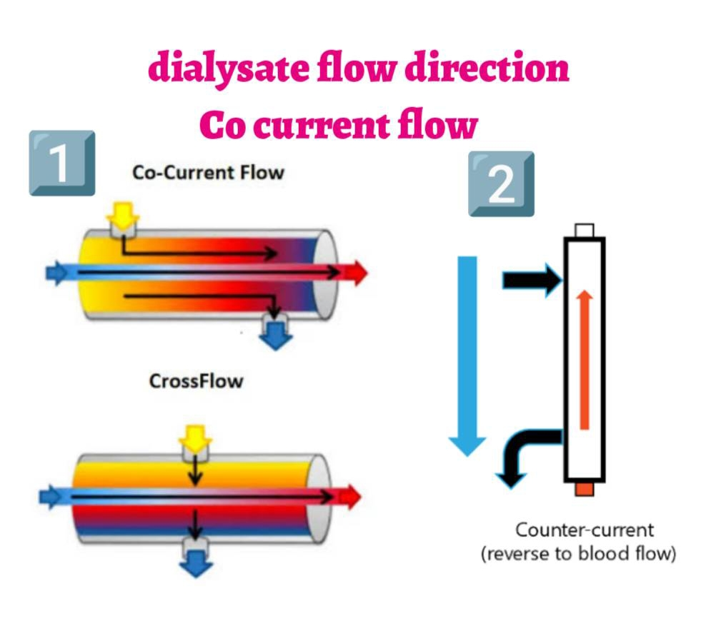
Some advocate the use of concurrent dialysate flow to slow the dialytic process in severely uremic patients who are starting dialysis Intravenous mannitol solution and the addition of urea to the dialysate have also been used.

Slide 11
In severely acidotic patients,
dialysate bicarbonate should be reduced for initial dialysis treatments
Mild symptoms of DDS
Nausea vomiting
headache
are common and are difficult to assign specifically to this syndrome.
Treatment is symptomatic and discussed above.
If DDS is suspected, reducing blood flow and reducing the UFR slows the dialysis process.

Slide 12
A hypertonic solutions can be administered and if symptoms persist, dialysis treatment should be terminated
and the patient managed symptomatically
In severe cases (obtundation, seizure or alteration of cousciousness),
l dialysis should be terminated and the symptoms managed medically.
Supportive treatment and symptomatic management should be initiated

Slide 13
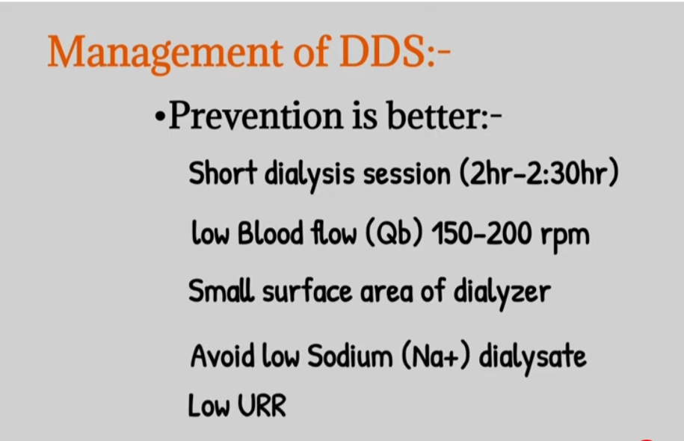
Supportive treatment and symptomatic management should be initiated
Intravenous mannitol solution may be useful. With supportive therapy
Most patients improve in 24-48 hours.

Slide 14

We win or learn, we never lose.

