Slide 1

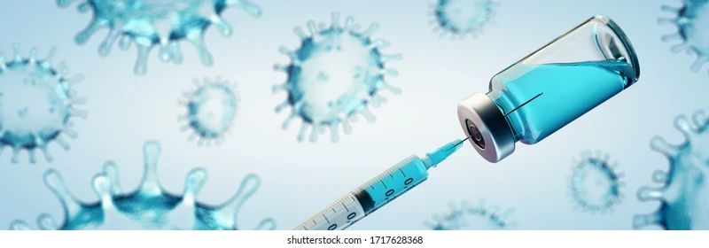

VACCINATION IN CHRONIC KIDNEY DISEASE
VACCINATION
IN
CHRONIC KIDNEY DISEASE

Slide 2
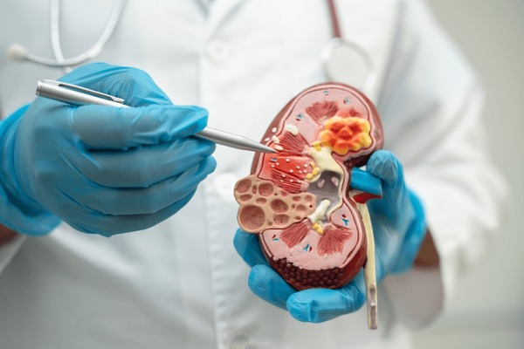
How kidneys work?
Kidneys filter waste and excess fluid from the blood. As kidneys fails, waste build up.
CHRONIC KIDNEY DISEASE:
Involves progressive, irreversible loss of kidney function.
A longstanding disease of kidneys leads to renal failure.

Slide 3
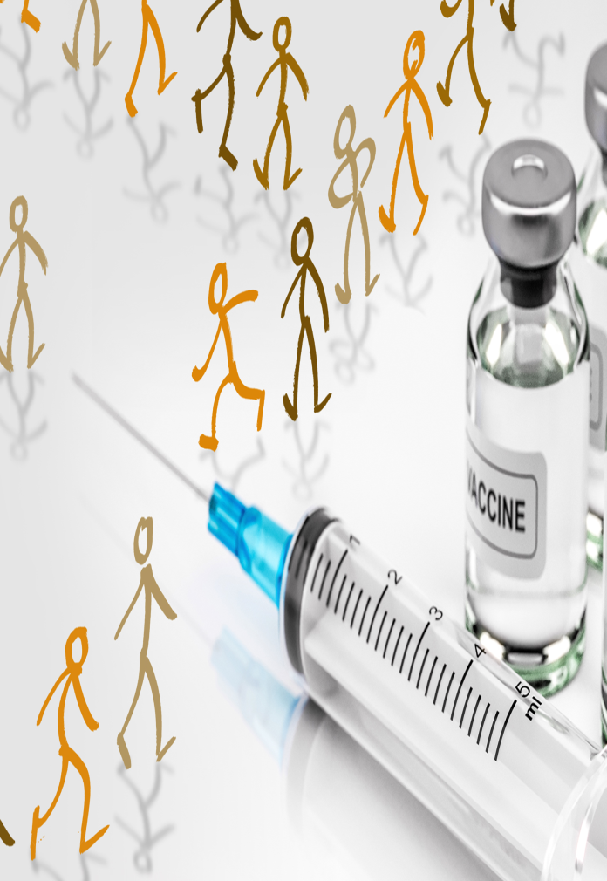
What is vaccination?
Vaccines consist of immuno-biological substance that is designed to produce specific protection against a given disease.
Vaccination is a method of giving antigen to stimulate the immune response through active immunization

Slide 4



Why vaccination important?
Target specific diseases
Stop epidemics
Protect everyone who is
vaccinated

Slide 5
Vaccinations required in CKD patients
1
Hepatitis B vaccine
2
Pneumococcal vaccine (Prevenar-13)
3
Influenza vaccine
  Varicella vaccine (Varilix 0.5 ml)
4

Slide 6
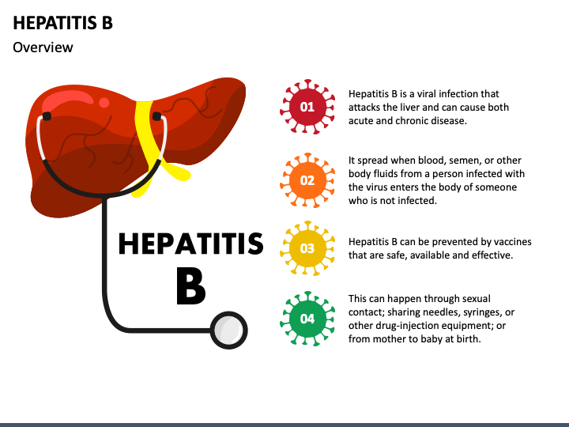
What is hepatitis B?

Slide 7
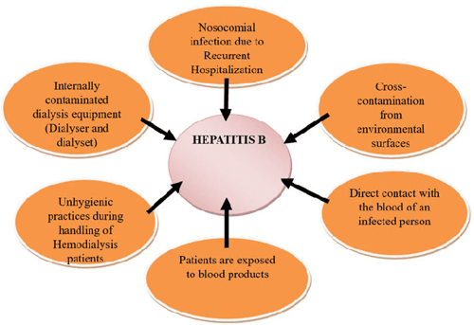
Who are at high risk?

Slide 8
Hepatitis B vaccine in CKD
hepatitis B vaccination is recommended to all CKD patients.
vaccine provide effective protection against the infection
vaccination in early stages of CKD has better seroconversion rate than late vaccination.

Slide 9
Dosage and schedule
Higher vaccine dosages or an increased number of doses are recommended for subjects with CKD (eGFR < 30 ml/min)
Patient should receive four doses of hepatitis B vaccine as early in the course of disease as possible.
Recomninant hepatitis B vaccine is recommended
Use special formulations of vaccine (40 mcg/ml) or two 1 ml 20 mcg doses given at one site. Dose schedule should be 0, 1, 2 and 6 months
Vaccine should be given intramuscular in deltoid regions

Slide 10
First titer should be done 1-2 months after the primary course is completed and annually thereafter.
Booster dose should be given if anti-HBs titer falls below 10mU/ml.
Revaccination with full doses is recommended for persons who do not develop protective antibody titer after primary course.
vaccines are shown to be safe for patients on dialysis with only minor local reactions including pain, redness or swelling at the vaccination site.

Slide 11
Pneumococcal vaccine (Prevenar-13)
Pneumococcal infection is caused by bacteria called streptococcus pneumoniae or pneumococcus. Pneumococcal infection can range from ear and sinus infections to pneumonia and bloodstream infections.
why patients with CKD are at high risk?
Patients co-morbidities, including diabetes, cardiovascular disease, asthma and chronic obstructive pulmonary disease were independently associated with increased risk of pneumonia.

Slide 12
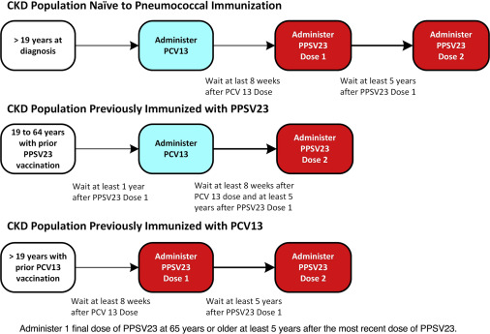

Slide 13
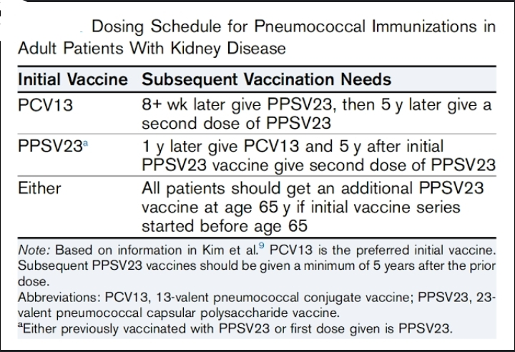

Slide 14
Influenza vaccine
Influenza is an infection of nose, throat and lungs which are part of respiratory system. This is caused by influenza virus.
Dialysis patients are increased risk of influenza-related mortality.
Four fold increase in serum antibody titer against influenza antigens have been observed in 50% of dialysis patients compared to 40% healthy controls.
No systemic reactions have been reported following influenza vaccination in dialysis patients.

Slide 15
Dosage and schedule:
Influenza vaccine should be given annually before the beginning of the influenza season for persons 6 months of age or olders on dialysis.
The vaccine dose is 0.5 ml intramuscular route 2 doses 4 weeks apart for those between the ages of 6-8yrs.
To those >9 yrs of age, 1 doses of influenza vaccine.
High risk groups yearly vaccine is recommended which includes CKD, chronic lung diseases, COPD, Asthma.
Target group for yearly immunization: elderly nursing home residents, health care professionals.

Slide 16
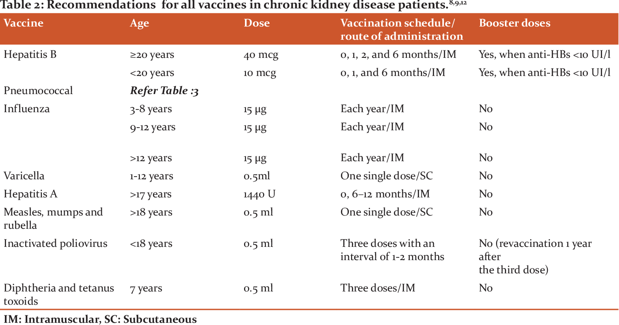

Slide 17


Slide 18

THANK YOU!

